Slide 1
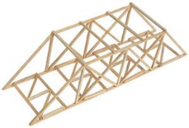
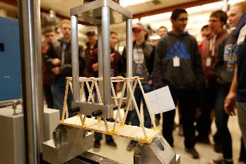
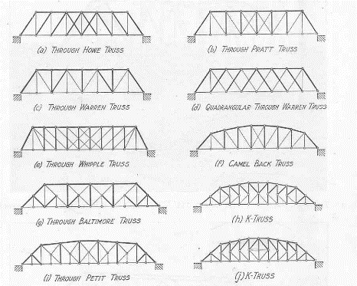
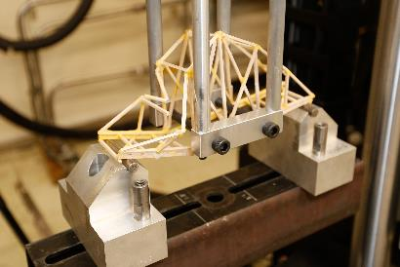
BALSA WOOD BRIDGE
Objective:
Build a bridge that can hold the most weight relative to its own weight.
Requirements:
Must be 12” long
Maximum of 3” wide
Must have clearance for two ½” pins 3” apart at center of bridge.
Height must be between 5” and 10”.
Must use glue and balsa provided.
Night 1 (2/21):
Design/start to build
Night 2 (3/7):
Head to MTL for test.

